Slide 1
Agentic AI Hackathon: Building Intelligent Agents with IBM Granite and LangFlow
TRAFFIC CONGESTION AGENT

Slide 2
Name of the team: SYNAPSE
Details of Team members
TEAM MEMBER NAME | Recent Passport Photo | Email ID | Phone number [WhatsApp]
Mohammed Arshaq |  | mohammedarshaq.cd23@bmsce.ac.in | 9380603624
Nazeef Ahsan Rafiqui |  | nazeefahsan.cd23@bmsce.ac.in | 8310069839
Nagaraj Nayak |  | nagarajbommayya.ci23@bmsce.ac.in | +91 73384 36427

Slide 3
Problem statement
Urban traffic congestion is increasing rapidly in metropolitan cities like Bangalore
Traffic data exists, but raw data is difficult to interpret in real time
Existing systems often:
  Mix analysis, causes, and explanations together
  Produce unstructured, chatbot-like responses
Lack of clear explainability for traffic stakeholders
Need for a system that can:
  Detect congestion accurately
  Explain what, why, and how in a structured manner

Slide 4
Proposed solution
A multi-agent traffic analysis system built using LangFlow
Uses historical traffic data (CSV) for analysis
Divides responsibility across three specialized AI agents:
Traffic state detection
Congestion cause attribution
Human-friendly explanation
Enforces strict role separation and output formats
Produces structured, predictable, and explainable outputs

Slide 5
Need of project
Traffic authorities need clear and reliable insights, not chat responses
Raw analytics are not suitable for:
Decision-makers
Demonstrations
Monitoring dashboards
Single-agent systems often:
Hallucinate
Over-explain
Mix causes and solutions
This project ensures:
Accuracy
Explainability
Trust in AI-driven traffic analysis
.

Slide 6
End user of project
Traffic management authorities
Smart city traffic monitoring teams
Urban transport planners
Data analysts working with traffic datasets
Demonstration and academic evaluation users

Slide 7
Technology Used
Langflow platform
Langflow component name – Agent , File Loader , Chat input , Chat output
IBM Grainte model - ibm-granite-3-2-8b
IBM Cloud
IBM Watsonx.ai
Watsonx

Slide 8
Novelty and Uniqueness
Clear agent-wise responsibility
Machine-readable outputs for dashboards
Human-readable explanations for operators
No external data dependency
Demo-ready and scalable architecture
Can be extended to:
  Live traffic feeds
  City-wide monitoring systems

Slide 9
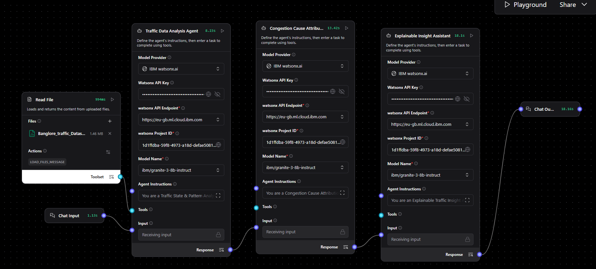
Technical flow diagram - Architecture blueprint

Slide 10
Langflow component Used
1) Chat Input
Accepts user traffic details (location, day type, time window)
Acts as the entry point of the system
2) IBM watsonx AI Agent
Performs traffic analysis using IBM Granite model
Used as multiple agents for:
Congestion detection and pattern analysis
  Cause attribution
  Explainable traffic insights
3) File Component (CSV Loader)
Loads Bangalore Traffic dataset
Acts as the single data source for all agents
4) Chat Output
Displays final traffic congestion explanation
Provides clear, human-readable results
5) Agent Instructions (System Prompt)
Defines roles and output format for each agent
Ensures explainable and structured responses

Slide 11
Future Scope
Advanced Explainability with External Factors
Future versions can incorporate external factors such as weather conditions, road incidents, public events, and construction work to provide more comprehensive and context-aware congestion explanations.
Predictive Traffic Congestion Analysis
By integrating time-series forecasting and machine learning models, the system can be enhanced to predict future congestion patterns and peak traffic periods in advance.
Decision Support for Traffic Authorities
The explainable insights generated by the system can be integrated into traffic control dashboards to assist traffic operators in planning signal timings, diversions, and policy decisions.
Public-Facing Traffic Awareness Applications
The system can be adapted into a mobile or web application to provide commuters with transparent explanations of traffic conditions, improving trust and travel planning.
·
·
·

Slide 12
Git Hub Link
Github URL – https://github.com/md-arshaq/Traffic-Congestion-Agent
·
·
·

Slide 13
References
· Please add link for references
·
·
·

Slide 14


